Slide 1
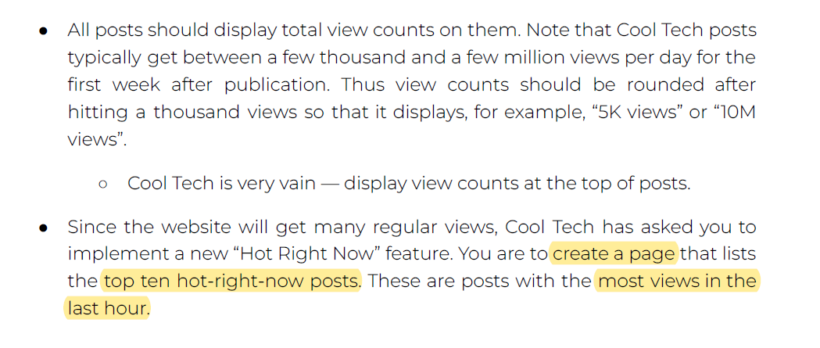
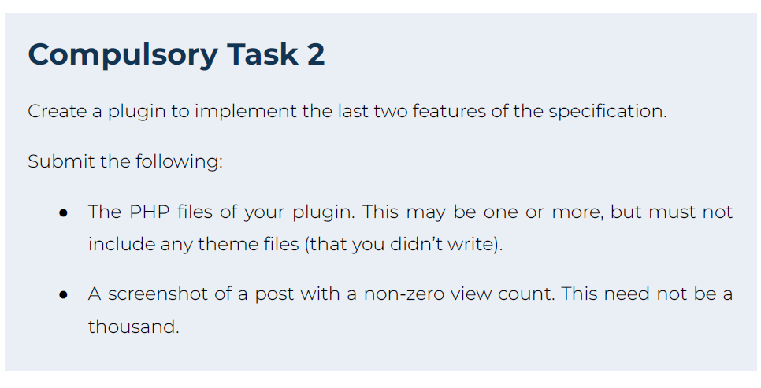
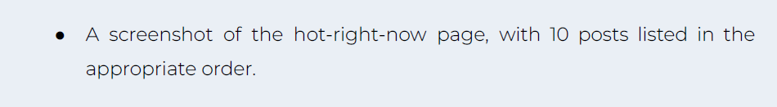

Slide 2
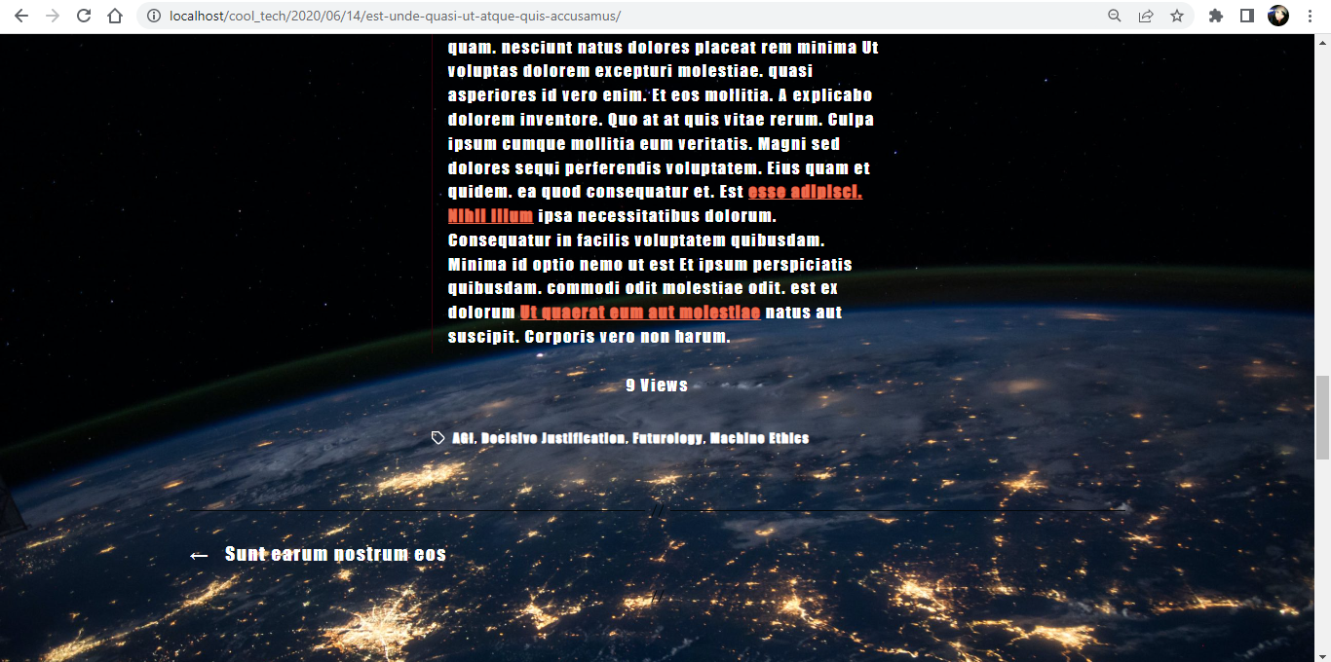
Create a plugin to implement the last two features of the specification.
Submit the following:
● The PHP files of your plugin. This may be one or more, but must not include any theme files (that you didn’t write). (PHP FILES IN TASK 2 FOLDER)
● A screenshot of a post with a non-zero view count. This need not be a thousand.

Slide 3
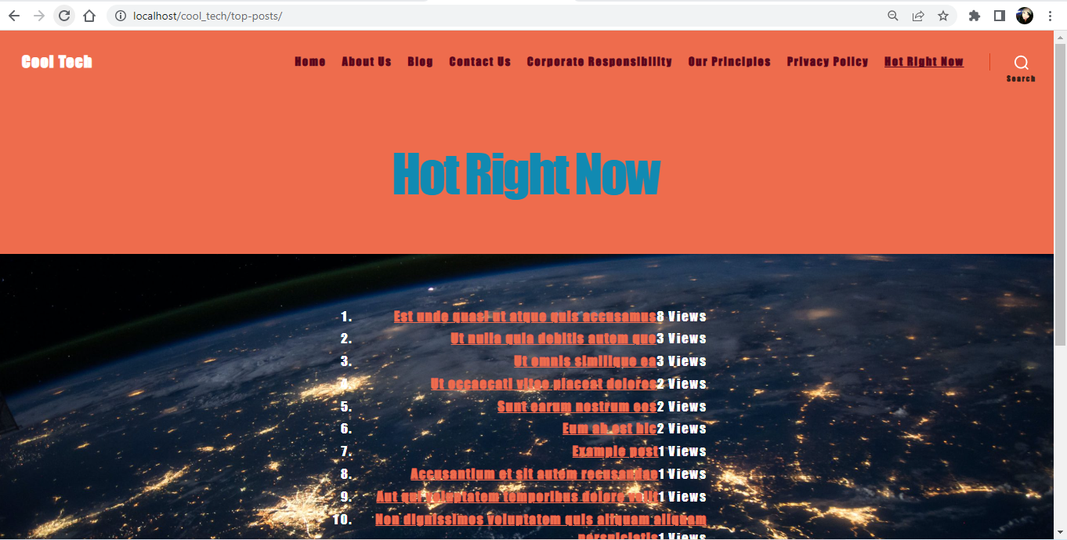
● A screenshot of the hot-right-now page, with 10 posts listed in the appropriate order.

